Slide 1
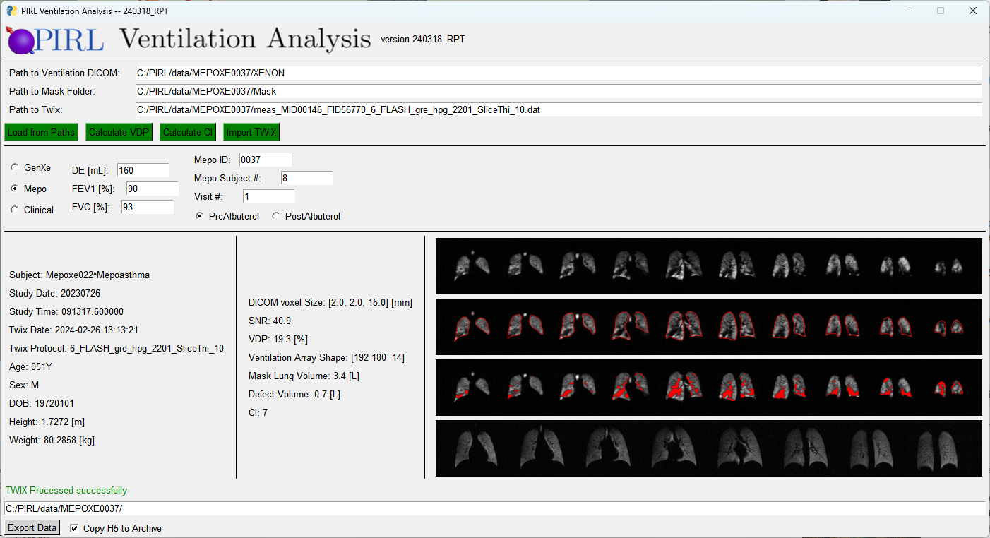
The Ventilation Analysis Program First Published 3/19/2024, RPT

Slide 2
Enter paths to the ventilation DICOM, Mask dicom folder, and corresponding ventilation TWIX file here
The Action Buttons:
they turn green when run successfully!
Load from Paths: creates the Vent_Analysis class object given you Ventilation DICOM and Masks
Calculate VDP: calculates N4 bias corrected ventilation, mean-anchored defect array, and VDP. This will update the 2nd and 3rd image rows in the display
Calcuate CI: calculates CI array (this can take a few minutes)
Import TWIX: Imports the raw data TWIX file to save with the DICOMS
Select the IRB associated with the study (General Xenon, Mepo, or a clinical scan), and enter the requested info. If you don’t have the info just leave blank.
Here, info pulled from the DICOM and TWIX headers is displayed. If it’s blank, it’s either not in the header or you didn’t run it (check that the action buttons are green)
The image display window shows 4 rows of images:
the DICOM ventilation images
The N4bias-corrected images with mask border overlay
The N4 images with defects
The TWIX images (make sure these correspond to the DICOM images!!)
The status bar shows the most recent update in processing
Here’s the path you plan to save the data in H5 format and as Niftis when you press the ‘Export Data’ button
Checking the ‘Copy to H5 Archive’ box tells the program to also save the H5 file into the archive path: '//umh.edu/data/Radiology/Xenon_Studies/Studies/H5/’
If you’ve run all actions successfully and are on a work computer with access to the shared drive, go ahead and check this and the H5 file will also be saved to this directory

Slide 3
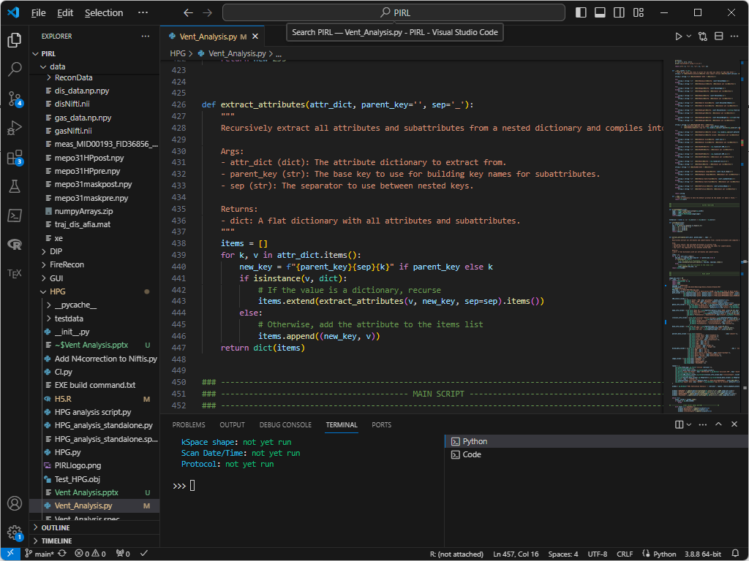
The program can be run in 1 of 3 ways:
Debug method:
Just select the entire script (ctrl+a) and run it all in the VS console (shift+Enter). This method stores everything in the global workspace so you can examine elements in the python console as you go.
Vscode Direct Run method (recommended for PIRL day-to-day usage):
Click the ‘Run code’ button at the top left (or ctrl+alt+n). This compiles the code and runs from the powershell. This is considerably faster and is closer to how app will run when compiled into an exe. It has the advantage that all console outputs can still be seen in the powershell, but you can’t really debug by playing with variables the python global workspace.
Run the compiled exe app:
Standalone exe’s are created using the module ‘PyInstaller’. That way you can run the program from any computer, even those without python. These apps tend to be big since they contain the full python compiler and all installed dependencies (every module contained in your python site libraries is included!). It’s the easiest way to run python code especially for non-coder friends (e.g. radiologists), BUT exe’s are often blocked by IT on work computers. I’m working on getting around this now.

Slide 4
In the next few Slides we’ll examine the Vent_Analysis class structure and methods
These were updated on 3/19/2024 for version 240319_RPT

Slide 5
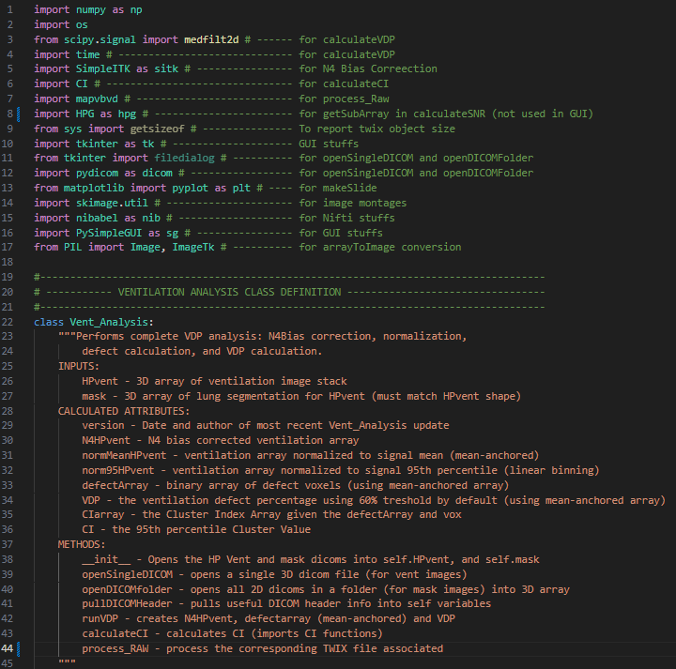
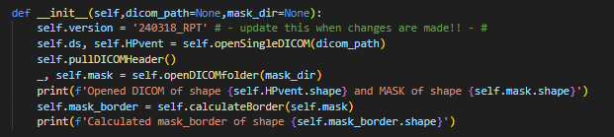
This ventilation analysis uses a Vent_Analysis class structure to produce VDP’s.
At the top of the doc are all imported modules and I tried to indicate which specific functions call the modules.
The Class is initialized by calling
Vent1 = Vent_Analysis()
With 2 optional inputs: the path to a full 3D DICOM file containing the ventilation images, and the path to the folder containing the exported mask dicoms (which are often saved as separate 2D binary arrays from Slicer.
The class will then automatically open the ventilation DICOM as store as numpy array into HPvent , and the mask array into mask
The ventilation DICOM header is scraped for a few attributes, and the mask border is calculated (for display purposes only, e.g., the GUI)

Slide 6
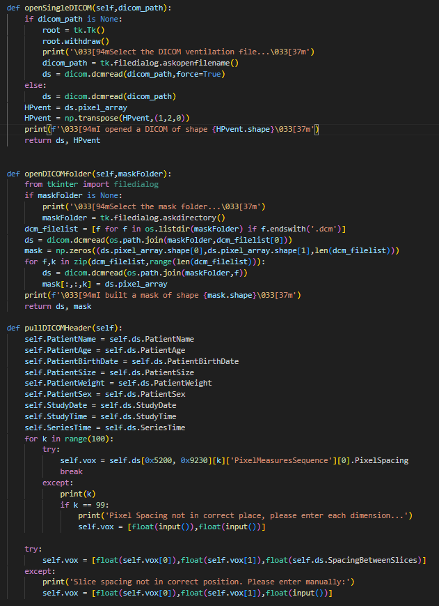
Vent_Analysis Methods:
openSingleDICOM() is used to open the single 3D ventilation DICOM array. The full DICOM object is stored in the ds attribute as well.
If a path is not specified, it will open a dialogue box asking the user to specify the file path.
openDICOMfolder() is essentially the same thing, but for the mask folder. Since the masks are saved as individual dcm files (one for each slice), this builds the mask array by opening each one. It also returns the final slice’s DICOM object, but I don’t use it for anything
pullDICOMHeader() checks the ventilation DICOM header for a few common DICOM attributes to and stores them as Vent_Analysis object attributes. The way a DICOM header is pulled is a giant dictionary – and sometimes the locations of certain keys is not the same for every DICOM file – for example, PixelSpacing which specifies the in-plane voxel dimensions is a fifth sub-dictionary (such a pain). So to get the pixel spacing, we fall in a for loop which tries subdictionaries of the [0x5200, 0x9230] address, and once it finds it, it breaks. If it doesn’t find the PixelSpacing, it will ask the user to specify each dimension in the console. Same for SpacingBetweenSlices (slice thickness).

Slide 7
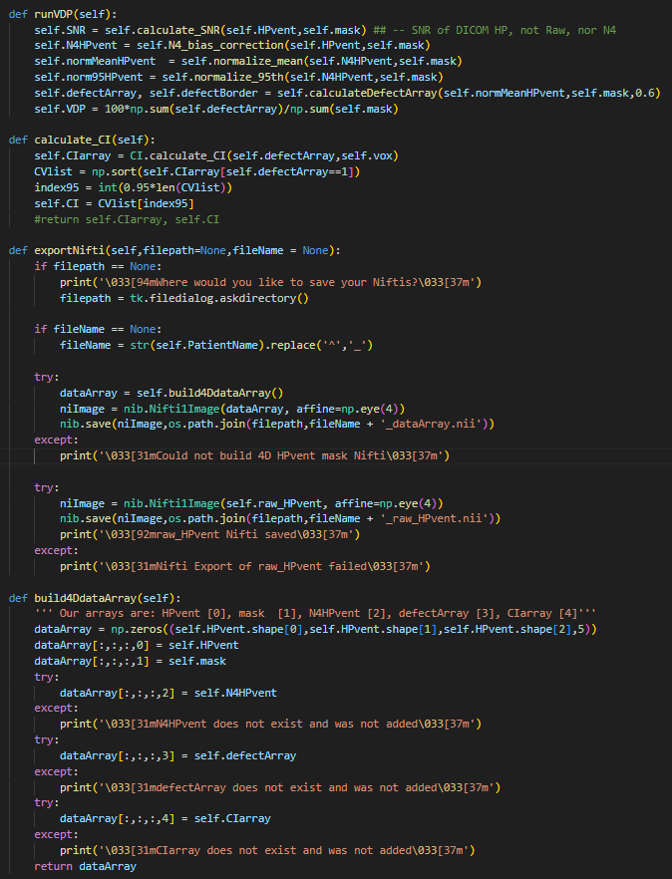
Vent_Analysis Methods:
runVDP() calculates VDP using the mean-anchored approach (Thomen et al. 2015 Radiology).
openDICOMfolder() calculates the Cluster Value map and subject’s cluster index.
exportNifti() will build a 4D array of Hpvent, mask, N4-bias-corrected-Hpvent, defectArray, and CI array. It calls build3DdataArray(), which is defined below.

Slide 8
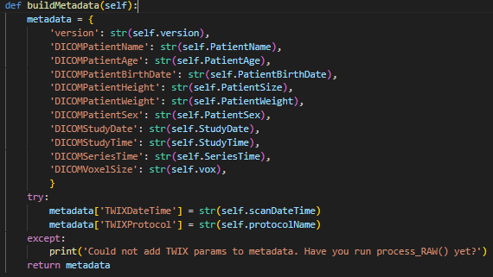
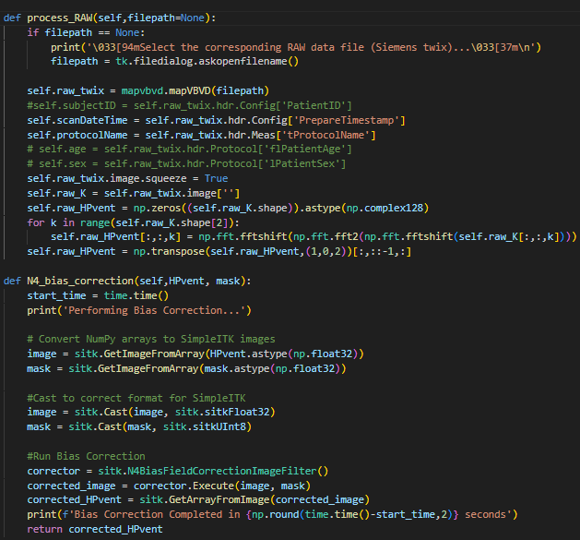
Vent_Analysis Methods:
buildMetadata() creates a dictionary of the pulsed DICOM and TWIX header values.
Process_RAW() Opens a TWIX file (obviously it should be the TWIX file which corresponds to the DICOM and mask data). And saves the scan data/time, protocol, k-space array, and image array (by fft-ing each slice of the k-space array). It also saves the TWIX object in memory (self.raw_twix) which is a massive attribute dictionary. Not much is pulled from this as an attribute, but the GUI export, will create a JSON file listing the entire dictionary.
N4_bias_correction() Performs N4itk Bias correction (Tustison). It requires the raw HPvent and mask. Returns the

Slide 9
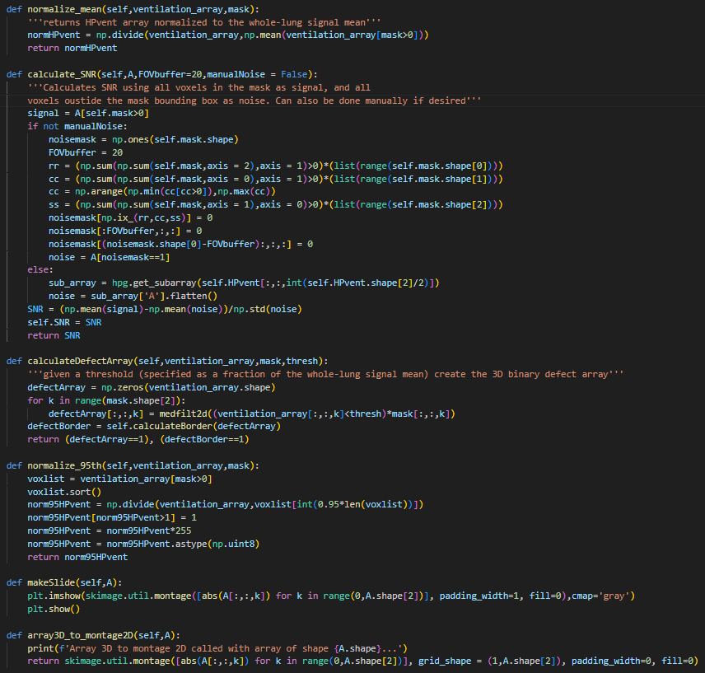
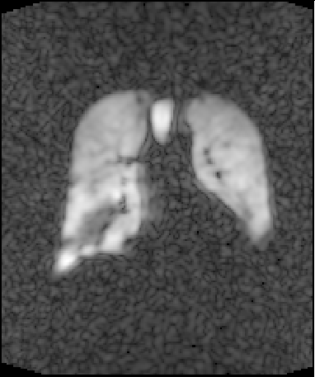
Vent_Analysis Methods:
Normalize_mean() creates NormMR – just HPvent normalized to its own signal mean (really doesn’t need to be its own function
Calculate_SNR() Calculates SNR. Signal is all voxels in the mask; noise is all voxels outside the box bounding the mask. Note that some DICOM images have zero-filled edges. The FOV buffer removes a certain number of rows/columns to avoid these pixels being counted as noise. You can also manually choose a noise box, by setting optional argument manualNoise=True, but this is not used in the GUI.
calculateDefectArray() Calculates the defect array as all voxels within the lung less than the threshold (so we pass in the normalized HPvent and 0.6 as the default threshold. Each slice’s defect array is median filtered to smooth the edge contour and remove singleton ‘noise’ defect voxels (Thomen et al 2015 Radiology).
Normalize_95th() creates norm95HPvent which is just Hpvent normalized to the 95th %-ile signal value (this is handy for display sometimes, but the GUI doesn’t use it
array3D_to_montage() turns a 3D array into a 2D array where slices are layed in a single row. Output array has shape (A.shape[0],A.shape[1]*A.shape[2])

Slide 10
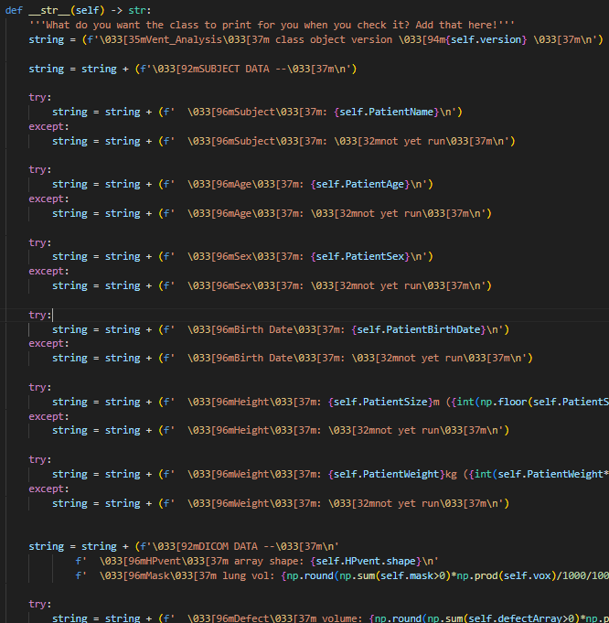
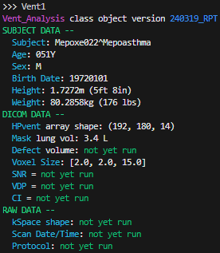

Vent_Analysis Methods:
One handy thing when creating a class structure in python is to implement a __str__() and/or __repr__() method.
When you check a class object in the console, by default it just tells you the object type and location in memory which isn’t super informative:
Defining a __repr__() function will let the console print whatever you want when the object is examined:

Slide 11
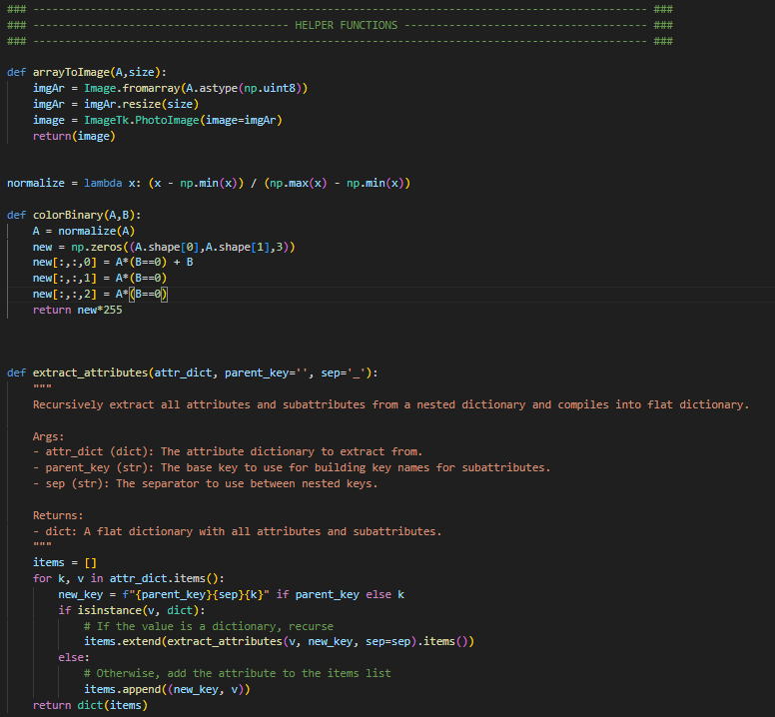
These function are not a part of the Vent_Analysis class structure. They’re just helpers mainly for the __main__() script which follows and generally just help simplify the GUI code.
arrayToImage():
Converts a 2D numpy array to an image object for display in the GUI
Normalize():
Lambda function which normalizes any numpy array from 0 to 1.
colorBinary(): Given a grayscale 2D array (A) and a binary 2D array (B), will return an RGB 3D array where the binary is overlayed in red on the grayscale. Used to showed the colored defect overlay, and mask border images.
Extract_attributes():
Give it a big dictionary (like the TWIX header), and it extracts all keys and values – even in subattributes. (Written by ChatGPT)

Slide 12
Here’s the main script which runs the GUI application
The GUI is made using the PySimpleGUI module which is built on tkinter. It’s essentially a very clean and easy way to build simple window GUIs to execute commands. Essentially, you build your window layout which is stored as a ‘window’ object. Then you display the window and drop into a while loop which is constantly checking for ‘events’ (button clicks, etc.) and ‘values’ (a dict which contains keys corresponding to each GUI element’s value, e.g. an text input and the string contained therein)
Let’s see how this works!...

Slide 13
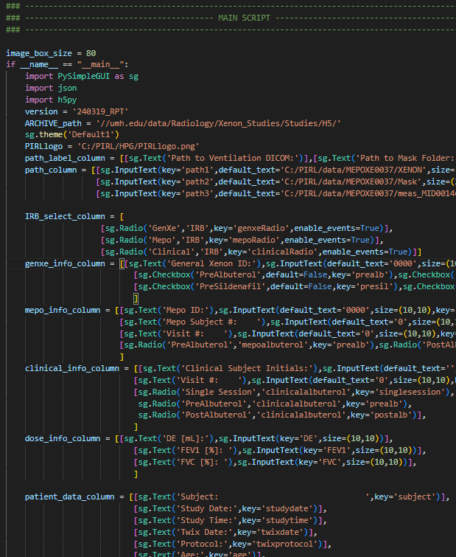
The GUI is built using several different element types such as Text displays, Radio buttons, Checkboxes, InputText, etc. I like to build little sections at a time like below. So for example, the path_column contains the three text input boxes which are built as a 2D list (note the two sets of brackets), when listed in the outer brackets, elements are place side-by-side, when elements are separated into inner brackets they are stacked. Each element has a ‘key’ associated with it – this lets you read the contents of an element later, and update the display.

Slide 14
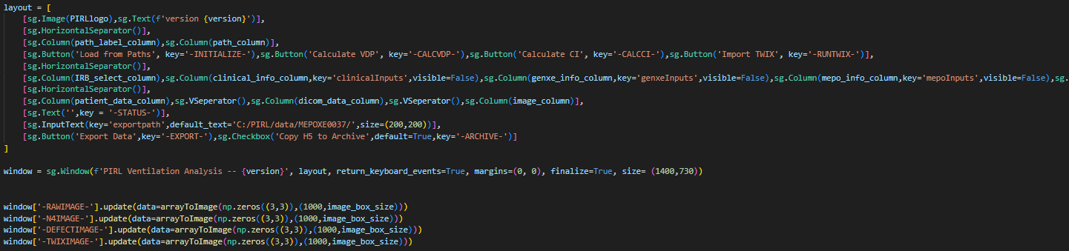
Once I’ve built the little sub-sections into individual lists, I can build the full GUI layout in the same way – just a list of lists. Note that I drop the sublists into sg.Column() elements to keep them side by side with their buddies on the same row.
Then the window is built using the declared layout. Note the size = (1400,730) required some trial and error. While the individual elements in the GUI may change size as it runs, the overall window size does not! Also, don’t forget the ‘finalize’ argument or it won’t think the window is ready to display. Running the code inline up to this point will result in the window being displayed but no functionality – we need to drop into the while loop for that.
The last section here fills the 4 image sections with black boxes mostly as placeholders. This also shows how elements in the window are altered by calling the element key from the window and running the ‘update’ method:
window['-RAWIMAGE-'].update(data=arrayToImage(np.zeros((3,3)),(1000,image_box_size)))
So here we’re telling it to update the –RAWIMAGE- element with the following arguments (essentially, rewriting the arguments we called in the declarations earlier). We say the new image data is box of zeros (note that the numpy array must be converted to an Image object with the arrayToImage function), and the image size is 1000 wide and image_box_size tall. I found that image_box_size = 80 is a good size so I hardcoded it at the start of __main__()

Slide 15
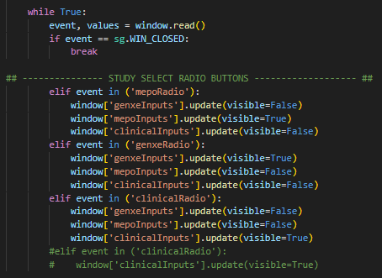
Now we drop into the while loop and the fun begins!
The while loop first reads the window elements and stores the values into events (when any event-triggering element is altered like a button is pressed), and values which is a dictionary of all defined keys in the layout and their respective values. If you want to debug, print the event and values here so you can see what it sees.
Then we just have a giant if/elseif statement which is checking the event to see what element was pressed. The whole rest of the loop is just going to be ‘if event was X button: do X button things’
So the first if just checks if the window is closed so it knows to break the while loop (very important so there’s always a way to stop the loop).
The next if statement we check

Slide 16

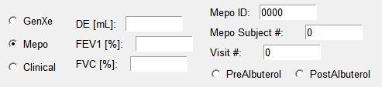

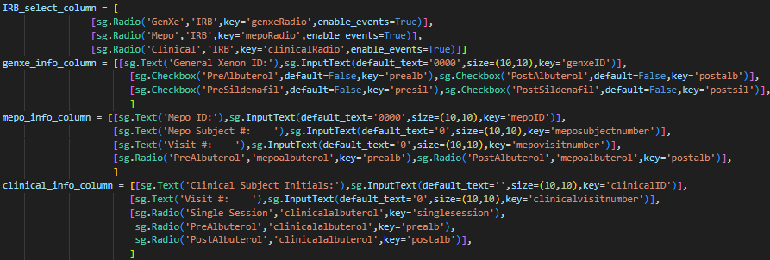
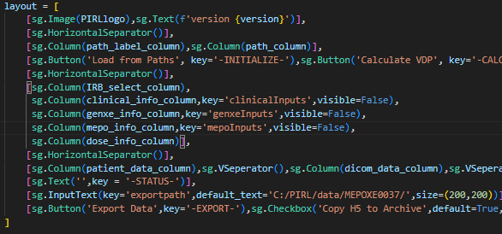
If the event was that one of the IRB radio buttons was selected (these guys)
Then we’ll display or hide different elements in the GUI. The three IRB selections are shown to the right
GenXe
You can see that clicking a radio button will make its elements visible, but the others invisible. These keys belong to the sg.Column() elements as shown in the layout below
Mepo
Clinical
Here’s the breakdown of the elements in the ‘pre-layout’ declarations
When the data is exported later, the IRB-specific elements will populate the header and alter the filename (e.g., Mepo-0000 vs Xe-0000, etc.)

